Slide 1
Ranked retrieval
Nisheeth

Slide 2
Ch. 6
Ranked retrieval
Thus far, our queries have all been Boolean.
Documents either match or don’t.
Good for expert users with precise understanding of their needs and the collection.
Also good for applications: Applications can easily consume 1000s of results.
Not good for the majority of users.
Writing Boolean queries is hard

Slide 3
Ch. 6
Problem with Boolean search: feast or famine
Boolean queries often result in either too few (=0) or too many (1000s) results.
Query 1: “standard user dlink 650” → 200,000 hits
Query 2: “standard user dlink 650 no card found”: 0 hits
It takes a lot of skill to come up with a query that produces a manageable number of hits.
AND gives too few; OR gives too many

Slide 4
Ranked retrieval models
Rather than a set of documents satisfying a query expression, in ranked retrieval, the system returns an ordering over the (top) documents in the collection for a query
Free text queries: Rather than a query language of operators and expressions, the user’s query is just one or more words in a human language
Ranked list of results: No more feast or famine

Slide 5
Ch. 6
Scoring as the basis of ranked retrieval
We wish to return in order the documents most likely to be useful to the searcher
How can we rank-order the documents in the collection with respect to a query?
Assign a score – say in [0, 1] – to each document
This score measures how well document and query “match”.

Slide 6
Ch. 6
Query-document matching scores
We need a way of assigning a score to a query/document pair
If the query term does not occur in the document: score should be 0
The more frequent the query term in the document, the higher the score (should be)

Slide 7
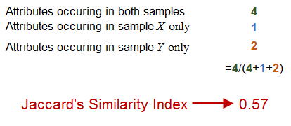
Ch. 6
Jaccard coefficient
jaccard(A,B) = |A ∩ B| / |A ∪ B|
jaccard(A,A) = 1
jaccard(A,B) = 0 if A ∩ B = 0
Always assigns a number between 0 and 1.

Slide 8
Ch. 6
Issues with Jaccard for scoring
Privileges shorter documents
We need a more sophisticated way of normalizing for length
It doesn’t consider term frequency
how many times a term occurs in a document
Does not account for term informativeness
How important is the term in the document

Slide 9
Sec. 6.2
Accounting for term frequency
Each document is represented by a binary vector ∈ {0,1}^{|V|}

Slide 10
Term frequency tf
The term frequency tf_{t,d} of term t in document d is defined as the number of times that t occurs in d.
We want to use tf when computing query-document match scores. But how?
Raw term frequency is not what we want:
A document with 10 occurrences of the term is more relevant than a document with 1 occurrence of the term.
But not 10 times more relevant.

Slide 11
Sec. 6.2
Log-frequency weighting
The log frequency weight of term t in d is
0 → 0, 1 → 1, 2 → 1.3, 10 → 2, 1000 → 4, etc.
Score for a document-query pair: sum over terms t in both q and d:
score
The score is 0 if none of the query terms is present in the document.

Slide 12
Sec. 6.2.1
Document frequency
Rare terms are more informative than frequent terms
Recall stop words
Consider a term in the query that is rare in the collection (e.g., arachnocentric)
A document containing this term is very likely to be relevant to the query arachnocentric
→ We want a high weight for rare terms like arachnocentric.

Slide 13
Sec. 6.2.1
Document frequency, continued
Frequent terms are less informative than rare terms
Consider a query term that is frequent in the collection (e.g., high, increase, line)
A document containing such a term is more likely to be relevant than a document that doesn’t
But it’s not a sure indicator of relevance.
How/when will it break?

Slide 14
idf weight
df_{t} is the document frequency of t: the number of documents that contain t
df_{t} is an inverse measure of the informativeness of t
df_{t} ≤ N
We define the idf (inverse document frequency) of t by
We use log (N/df_{t}) instead of N/df_{t} to “dampen” the effect of idf.

Slide 15
idf example, suppose N = 1 million
term | df_{t} | idf_{t}
calpurnia | 1 | 6
animal | 100 | 4
sunday | 1,000 | 3
fly | 10,000 | 2
under | 100,000 | 1
the | 1,000,000 | 0
There is one idf value for each term t in a collection.

Slide 16
tf.idf weighting
The tf.idf weight of a term is the product of its tf weight and its idf weight.
Best known weighting scheme in information retrieval
Increases with the number of occurrences within a document
Increases with the rarity of the term in the collection

Slide 17
Effect of idf on ranking
Does idf have an effect on ranking for one-term queries, like
iPhone
idf has no effect on ranking one term queries
idf affects the ranking of documents for queries with at least two terms
For the query capricious person, idf weighting makes occurrences of capricious count for much more in the final document ranking than occurrences of person.

Slide 18
Score for a document given a query
There are many variants
How “tf” is computed (with/without logs)
Whether the terms in the query are also weighted
…

Slide 19
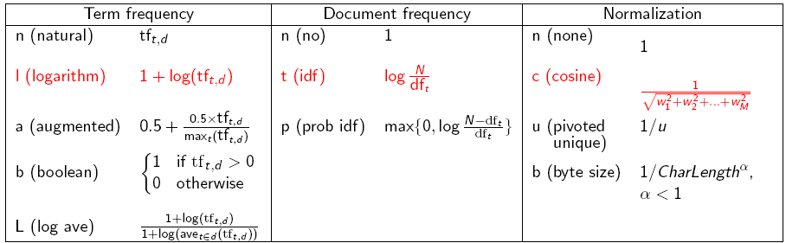
tf-idf weighting has many variants
Columns headed ‘n’ are acronyms for weight schemes.

Slide 20
Weighting may differ in queries vs documents
Many search engines allow for different weightings for queries vs. documents
SMART Notation: denotes the combination in use in an engine, with the notation ddd.qqq, using the acronyms from the previous table
A very standard weighting scheme is: lnc.ltc
Document: logarithmic tf (l as first character), no idf and cosine normalization
Query: logarithmic tf (l in leftmost column), idf (t in second column), no normalization …

Slide 21
tf-idf example: lnc.ltc
Document: car insurance auto insurance
Query: best car insurance
Term | Query |  |  |  |  |  | Document |  |  |  | Prod
 | tf-raw | tf-wt | df | idf | wt | n’lize | tf-raw | tf-wt | wt | n’lize
auto | 0 | 0 | 5000 | 2.3 | 0 | 0 | 1 | 1 | 1 | 0.52 | 0
best | 1 | 1 | 50000 | 1.3 | 1.3 | 0.34 | 0 | 0 | 0 | 0 | 0
car | 1 | 1 | 10000 | 2.0 | 2.0 | 0.52 | 1 | 1 | 1 | 0.52 | 0.27
insurance | 1 | 1 | 1000 | 3.0 | 3.0 | 0.78 | 2 | 1.3 | 1.3 | 0.68 | 0.53
Exercise: what is N, the number of docs?
Doc length =
Score = 0+0+0.27+0.53 = 0.8

Slide 22
Binary → count → weight matrix
Each document is now represented by a real-valued vector of tf-idf weights ∈ R^{|V|}

Slide 23
Sec. 6.3
Documents as vectors
So we have a |V|-dimensional vector space
Terms are axes of the space
Documents are points or vectors in this space
Very high-dimensional: tens of millions of dimensions when you apply this to a web search engine
These are very sparse vectors - most entries are zero.

Slide 24
Sec. 6.3
Queries as vectors
Key idea 1: Do the same for queries: represent them as vectors in the space
Key idea 2: Rank documents according to their proximity to the query in this space
proximity = similarity of vectors
proximity ≈ inverse of distance
We do this because we want to get away from the you’re-either-in-or-out Boolean model.
Instead: rank more relevant documents higher than less relevant documents

Slide 25
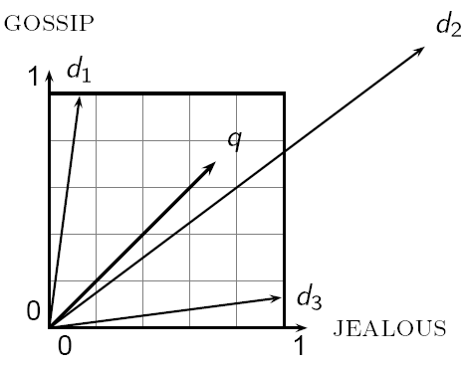
Euclidean distance is a bad idea
The Euclidean distance between q
and d₂ is large even though the
distribution of terms in the query q and the distribution of
terms in the document d₂ are
very similar.

Slide 26
Sec. 6.3
cosine(query,document)
Dot product
Unit vectors
q_{i} is the tf-idf weight of term i in the query
d_{i} is the tf-idf weight of term i in the document
cos(q,d) is the cosine similarity of q and d … or,
equivalently, the cosine of the angle between q and d.

Slide 27
Length normalization
A vector can be (length-) normalized by dividing each of its components by its length – for this we use the L₂ norm:
Dividing a vector by its L₂ norm makes it a unit (length) vector (on surface of unit hypersphere)
Effect on the two documents d and d′ (d appended to itself) from earlier slide: they have identical vectors after length-normalization.
Long and short documents now have comparable weights

Slide 28
Cosine for length-normalized vectors
For length-normalized vectors, cosine similarity is simply the dot product (or scalar product):
for q, d length-normalized.

Slide 29
Sec. 6.3
Cosine similarity amongst 3 documents
How similar are these novels
SaS: Sense and
Sensibility
PaP: Pride and
Prejudice, and
WH: Wuthering
Heights?
term | SaS | PaP | WH
affection | 115 | 58 | 20
jealous | 10 | 7 | 11
gossip | 2 | 0 | 6
wuthering | 0 | 0 | 38
Term frequencies (counts)
Note: To simplify this example, we don’t do idf weighting.

Slide 30
3 documents example contd.
Log frequency weighting
After length normalization
term | SaS | PaP | WH
affection | 3.06 | 2.76 | 2.30
jealous | 2.00 | 1.85 | 2.04
gossip | 1.30 | 0 | 1.78
wuthering | 0 | 0 | 2.58
term | SaS | PaP | WH
affection | 0.789 | 0.832 | 0.524
jealous | 0.515 | 0.555 | 0.465
gossip | 0.335 | 0 | 0.405
wuthering | 0 | 0 | 0.588
cos(SaS,PaP) ≈
0.789 × 0.832 + 0.515 × 0.555 + 0.335 × 0.0 + 0.0 × 0.0
≈ 0.94
cos(SaS,WH) ≈ 0.79
cos(PaP,WH) ≈ 0.69
Why do we have cos(SaS,PaP) > cos(SaS,WH)?

Slide 31
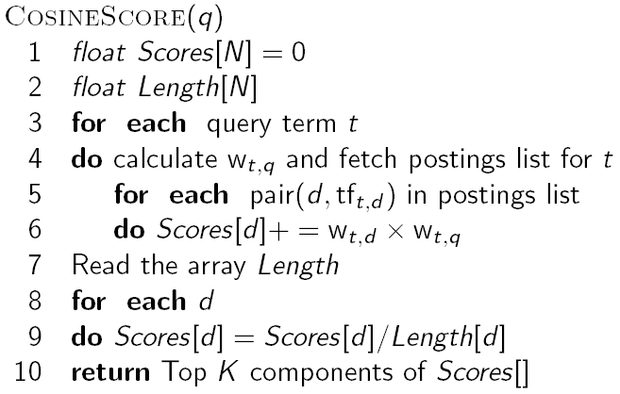
Computing cosine scores

Slide 32
Summary – vector space models
Represent the query as a weighted tf-idf vector
Represent each document as a weighted tf-idf vector
Compute the cosine similarity score for the query vector and each document vector
Rank documents with respect to the query by score
Return the top K (e.g., K = 10) to the user

Slide 33
Language models
Ranked retrieval

Slide 34
Trouble with frequency-based models
Too literal
Can’t deal with misspellings, synonyms etc.
Natural language queries are hard to deal with if you don’t address these difficulties

Slide 35
Language Model
Unigram language model
probability distribution over the words in a language
generation of text consists of pulling words out of a “bucket” according to the probability distribution and replacing them
N-gram language model
some applications use bigram and trigram language models where probabilities depend on previous words

Slide 36
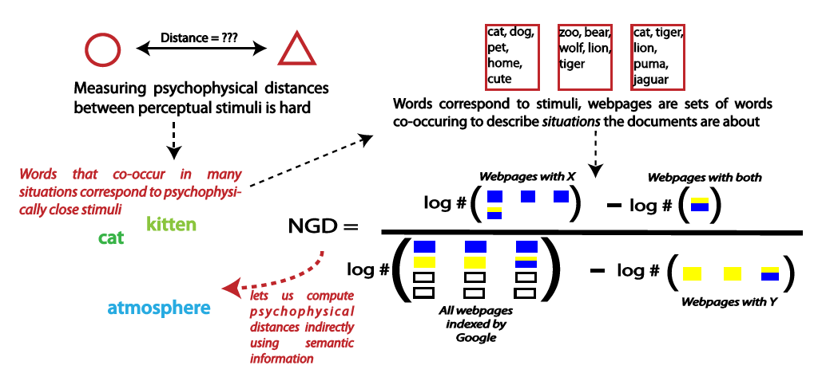
Semantic distance

Slide 37
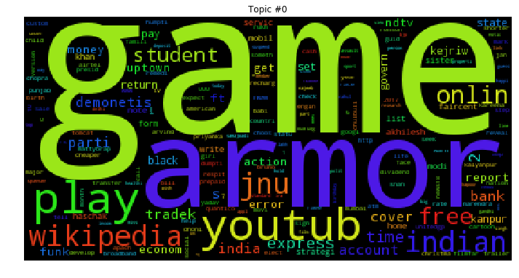
Sample topic

Slide 38
Language Model
A topic in a document or query can be represented as a language model
i.e., words that tend to occur often when discussing a topic will have high probabilities in the corresponding language model
The basic assumption is that words cluster in semantic space
Multinomial distribution over words
text is modeled as a finite sequence of words, where there are t possible words at each point in the sequence
commonly used, but not only possibility
doesn’t model burstiness

Slide 39
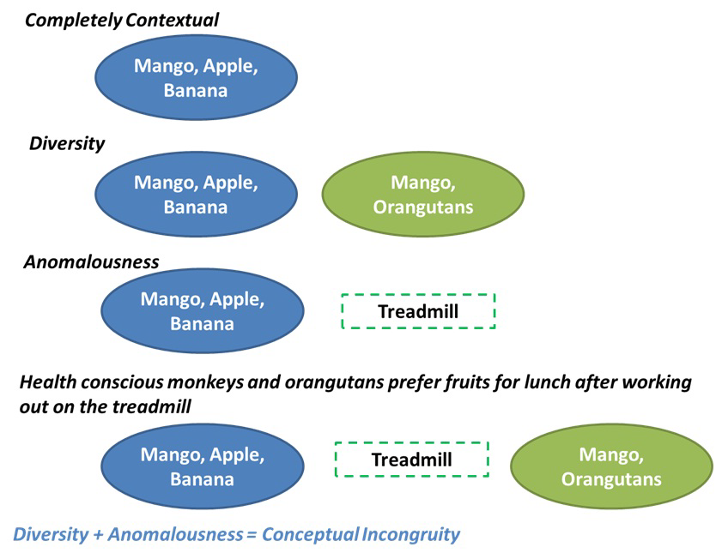
Has interesting applications

Slide 40
LMs for Retrieval
3 possibilities:
probability of generating the query text from a document language model
probability of generating the document text from a query language model
comparing the language models representing the query and document topics
Models of topical relevance

Slide 41
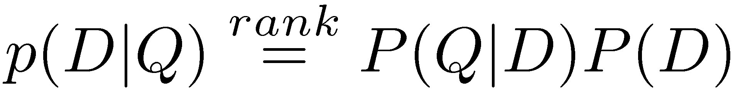
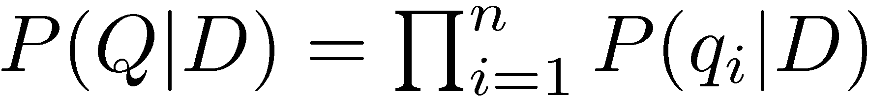
Query-Likelihood Model
Rank documents by the probability that the query could be generated by the document model (i.e. same topic)
Given query, start with P(D|Q)
Using Bayes’ Rule
Assuming prior is uniform, unigram model

Slide 42
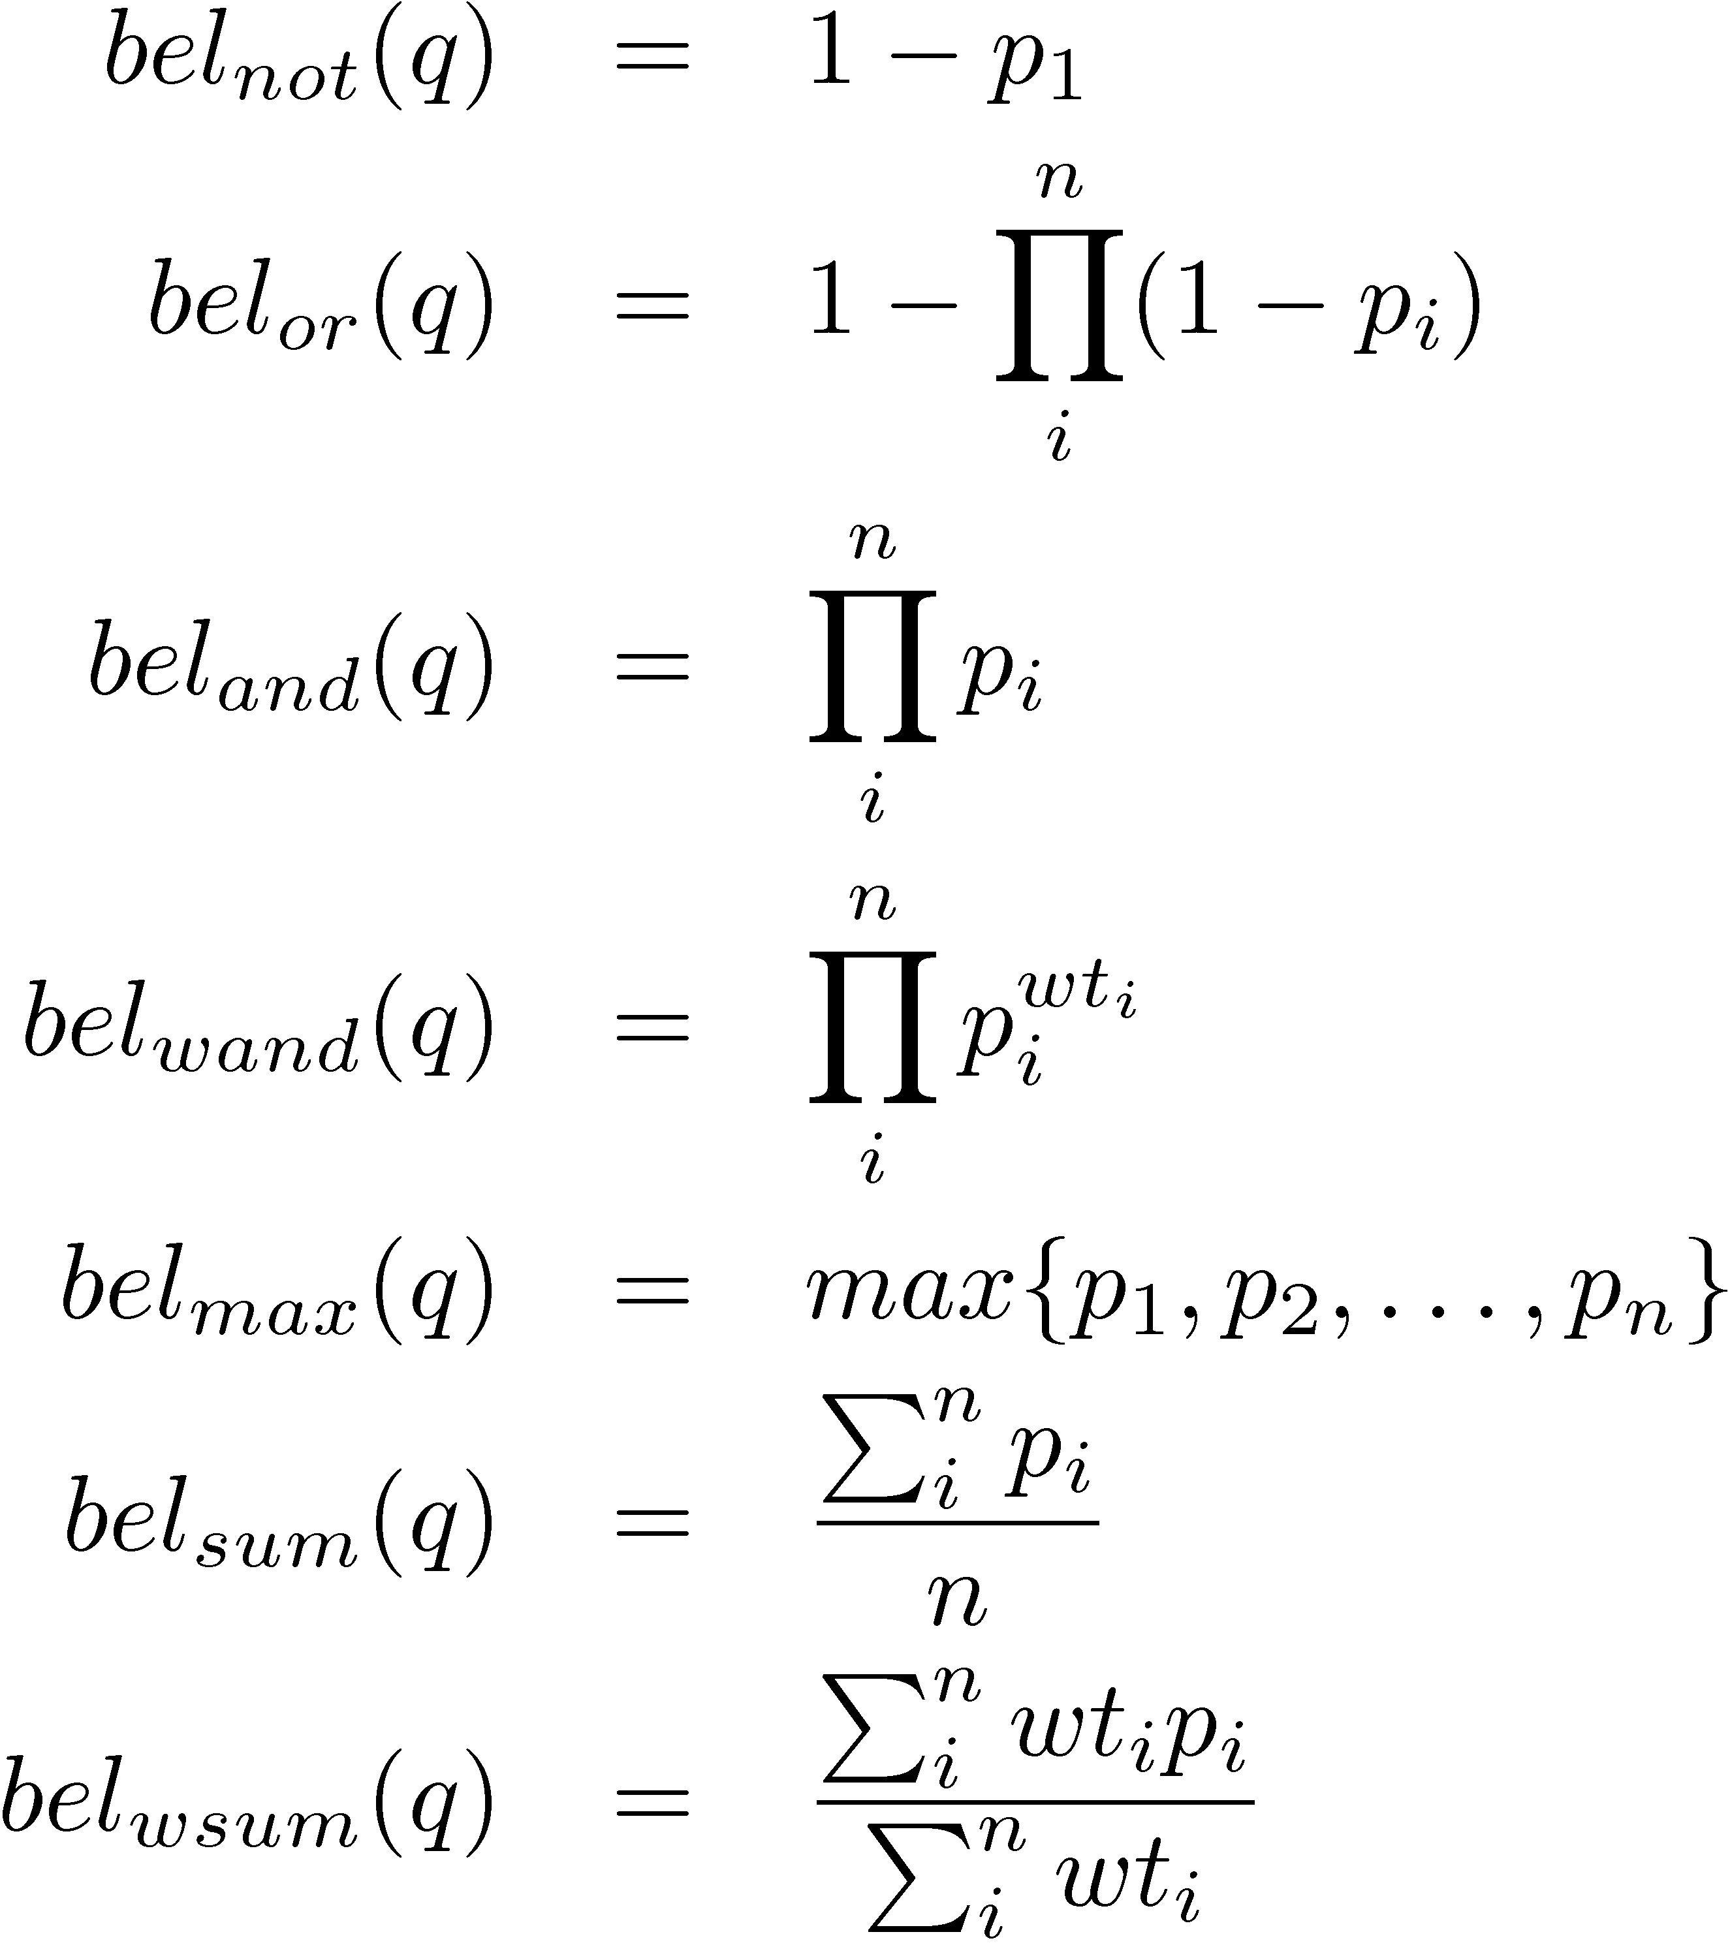
Other query constructions

Slide 43
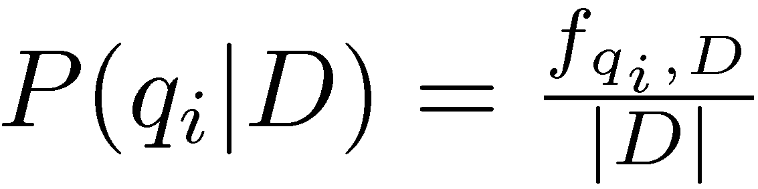
Estimating Probabilities
Obvious estimate for unigram probabilities is
Maximum likelihood estimate
makes the observed value of fqi;D most likely
If query words are missing from document, score will be zero
Missing 1 out of 4 query words same as missing 3 out of 4

Slide 44
Smoothing
Document texts are a sample from the language model
Missing words should not have zero probability of occurring
Smoothing is a technique for estimating probabilities for missing (or unseen) words
lower (or discount) the probability estimates for words that are seen in the document text
assign that “left-over” probability to the estimates for the words that are not seen in the text

Slide 45
Estimating Probabilities
Estimate for unseen words is α_{D}P(q_{i}|C)
P(q_{i}|C) is the probability for query word i in the collection language model for collection C (background probability)
α_{D} is a parameter
Estimate for words that occur is
(1 − α_{D}) P(q_{i}|D) + α_{D} P(q_{i}|C)
Different forms of estimation come from different α_{D}

Slide 46
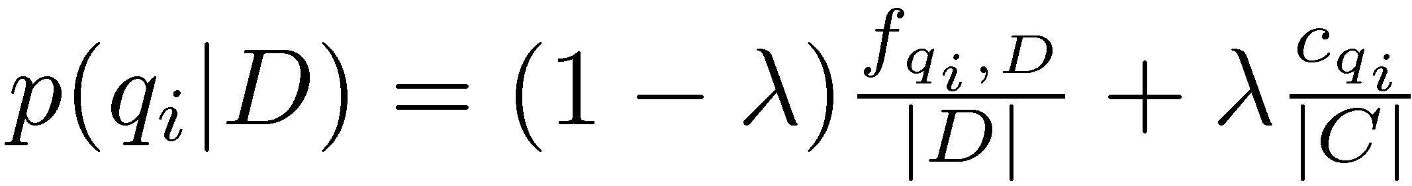
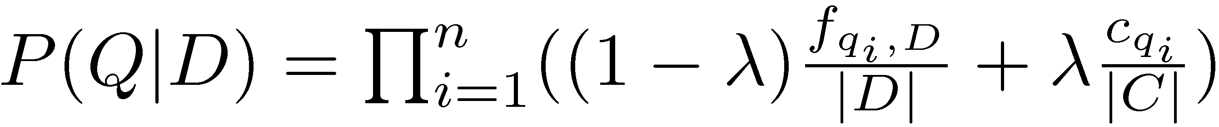
Jelinek-Mercer Smoothing
α_{D} is a constant, λ
Gives estimate of
Ranking score
Use logs for convenience
accuracy problems multiplying small numbers

Slide 47
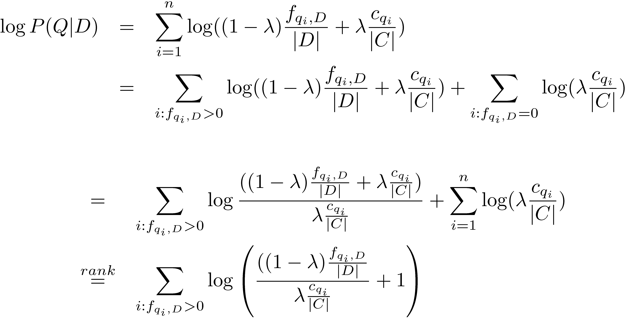
Compare with tf.idf
- proportional to the term frequency, inversely proportional to the collection frequency

Slide 48
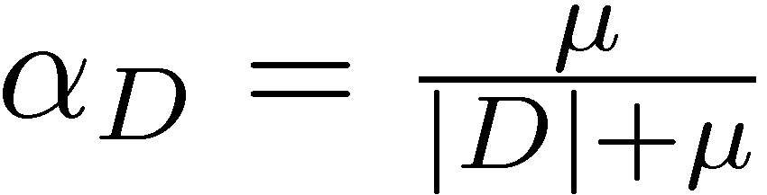
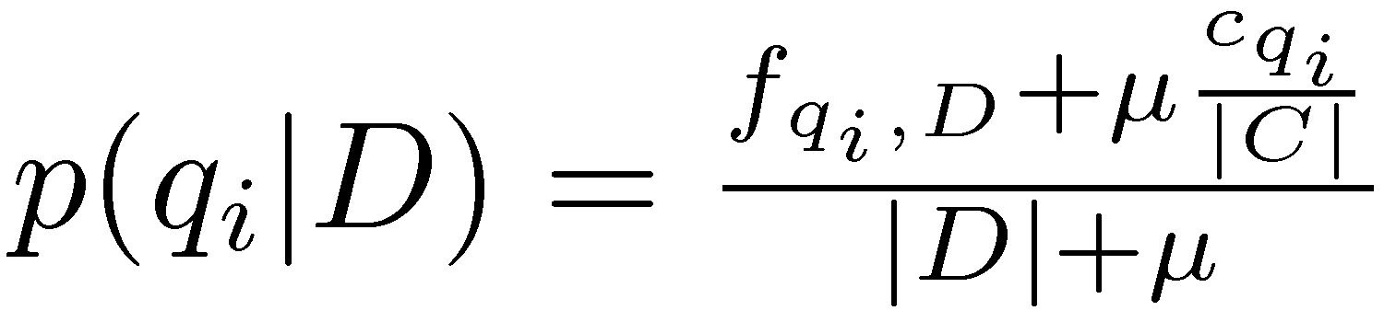
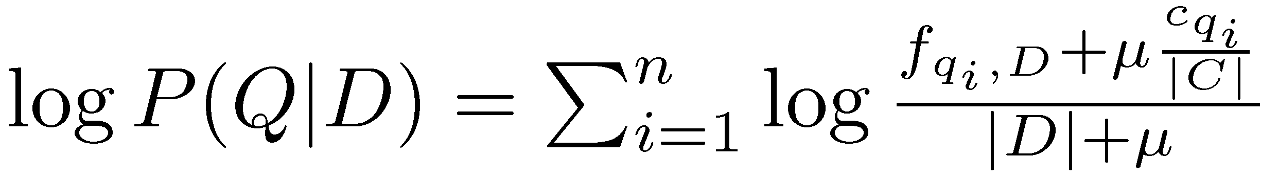
Dirichlet Smoothing
α_{D} depends on document length
Gives probability estimation of
and document score

Slide 49
Query Likelihood Example
For the term “president”
f_{qi,D} = 15, c_{qi} = 160,000
For the term “lincoln”
f_{qi,D} = 25, c_{qi} = 2,400
document |d| is assumed to be 1,800 words long
collection is assumed to be 10⁹ words long
500,000 documents times an average of 2,000 words
μ = 2,000

Slide 50
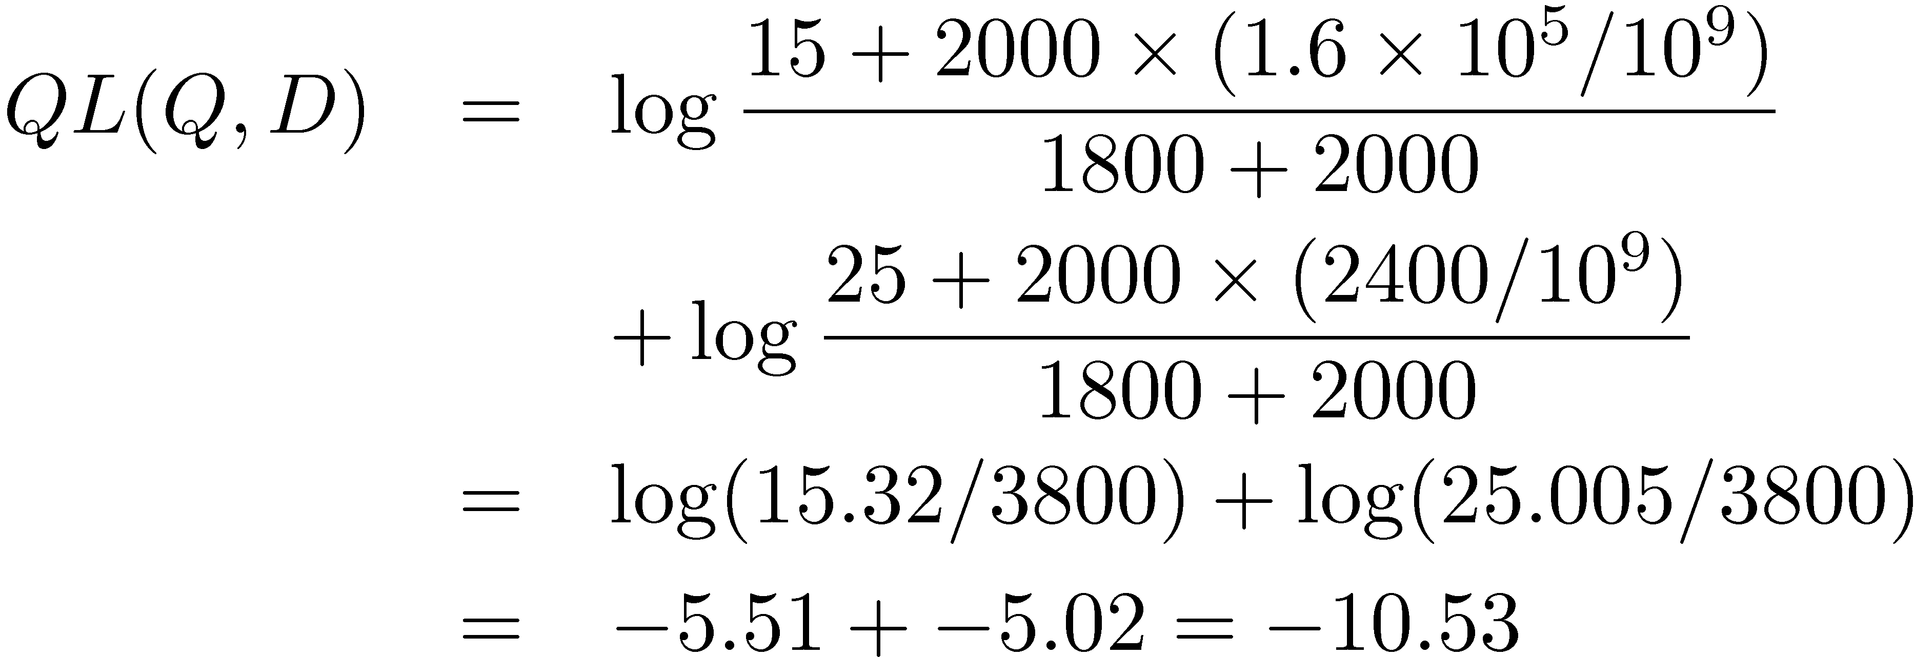
Query Likelihood Example
Negative number because summing logs of small numbers

Slide 51
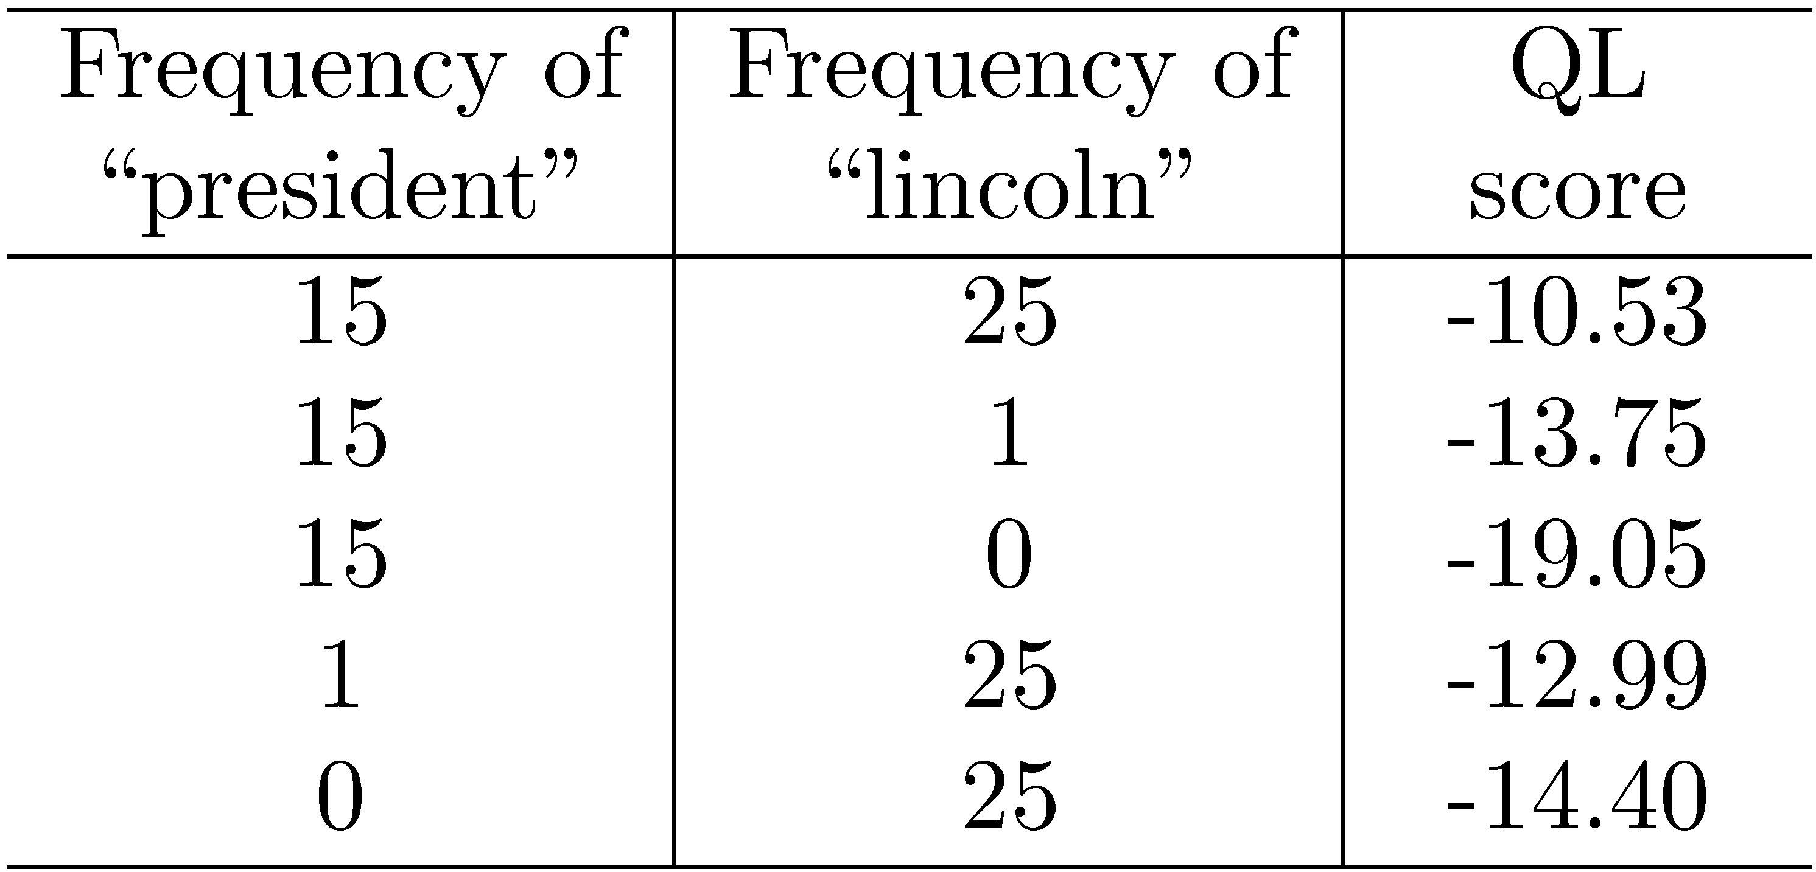
Query Likelihood Example

Slide 52
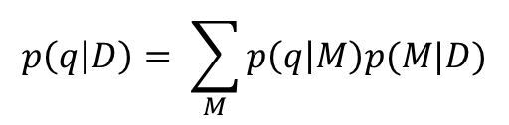
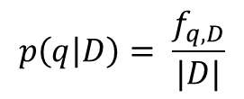
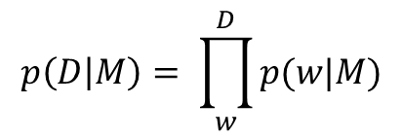
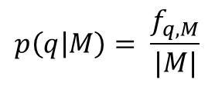
Going beyond tf.idf
D
D
M
q
q
$$p\left(q | D\right)= \sum_{M}{p\left(q | M\right)p(M|D)}$$
$$p\left(q | D\right)= \frac{f_{q,D}}{|D|}$$
$$p\left(q | M\right)= \frac{f_{q,M}}{|M|}$$
$$p\left(D | M\right)= \prod_{w}^{D}{p(w|M)}$$

Slide 53
Relevance Models
Relevance model – language model representing information need
query and relevant documents are samples from this model
P(D|R) - probability of generating the text in a document given a relevance model
document likelihood model
less effective than query likelihood due to difficulties comparing across documents of different lengths

Slide 54
Pseudo-Relevance Feedback
Estimate relevance model from query and top-ranked documents
Rank documents by similarity of document model to relevance model
Kullback-Leibler divergence (KL-divergence) is a well-known measure of the difference between two probability distributions

Slide 55
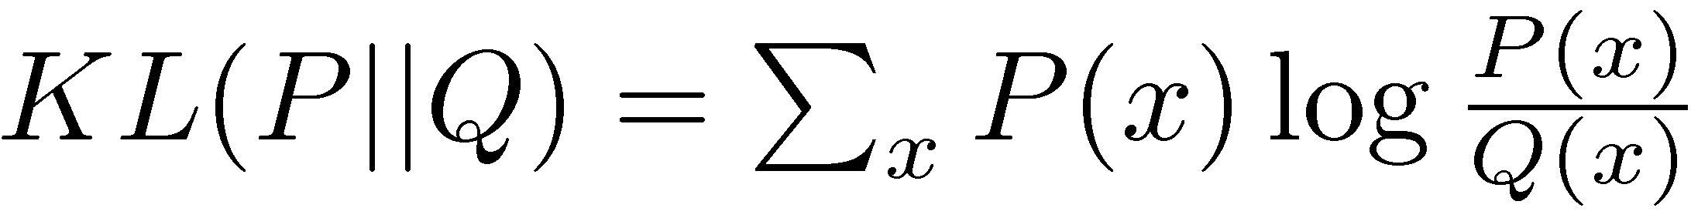
KL-Divergence
Given the true probability distribution P and another distribution Q that is an approximation to P,
Use negative KL-divergence for ranking, and assume relevance model R is the true distribution (not symmetric),

Slide 56
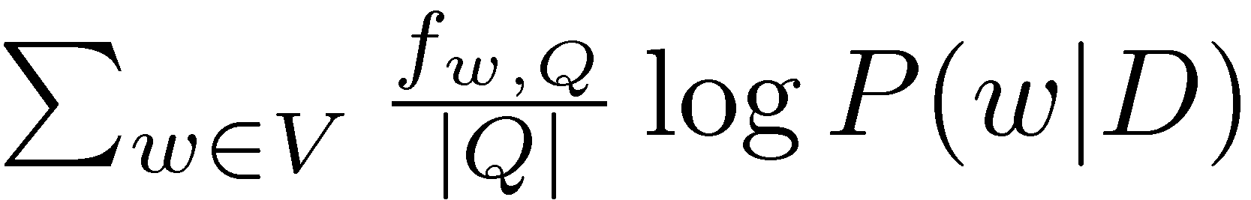
KL-Divergence
Given a simple maximum likelihood estimate for P(w|R), based on the frequency in the query text, ranking score is
rank-equivalent to query likelihood score
Query likelihood model is a special case of retrieval based on relevance model

Slide 57
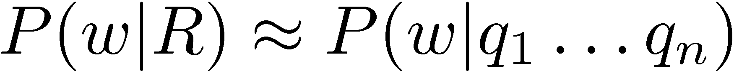
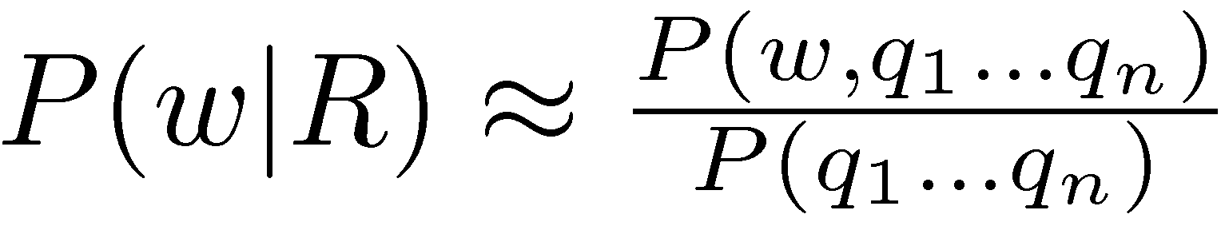
Estimating the Relevance Model
Probability of pulling a word w out of the “bucket” representing the relevance model depends on the n query words we have just pulled out
By definition

Slide 58
Estimating the Relevance Model
Joint probability is
Assume
Gives

Slide 59
Estimating the Relevance Model
P(D) usually assumed to be uniform
P(w, q1 . . . qn) is simply a weighted average of the language model probabilities for w in a set of documents, where the weights are the query likelihood scores for those documents
Formal model for pseudo-relevance feedback
query expansion technique

Slide 60
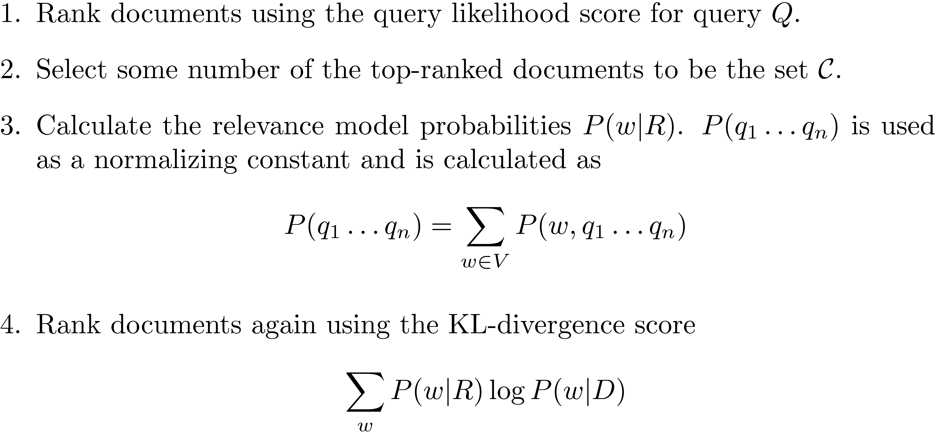
Pseudo-Feedback Algorithm

Slide 61
Combining Evidence
Effective retrieval requires the combination of many pieces of evidence about a document’s potential relevance
have focused on simple word-based evidence
many other types of evidence
structure, PageRank, metadata, even scores from different models
Inference network model is one approach to combining evidence
uses Bayesian network formalism

Slide 62
Inference Network

Slide 63
Inference Network
Document node (D) corresponds to the event that a document is observed
Representation nodes (r_{i}) are document features (evidence)
Probabilities associated with those features are based on language models θ estimated using the parameters μ
one language model for each significant document structure
r_{i} nodes can represent proximity features, or other types of evidence (e.g. date)

Slide 64
Inference Network
Query nodes (q_{i}) are used to combine evidence from representation nodes and other query nodes
represent the occurrence of more complex evidence and document features
a number of combination operators are available
Information need node (I) is a special query node that combines all of the evidence from the other query nodes
network computes P(I|D, μ)

Slide 65
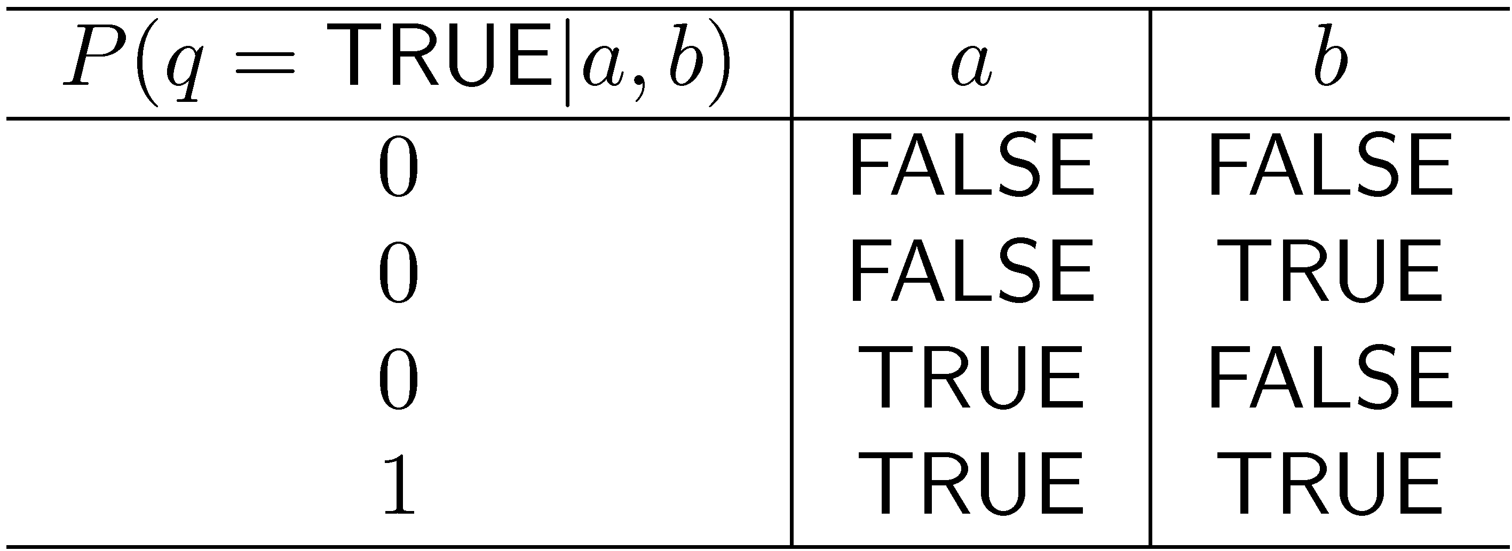
Example: AND Combination
a and b are parent nodes for q

Slide 66
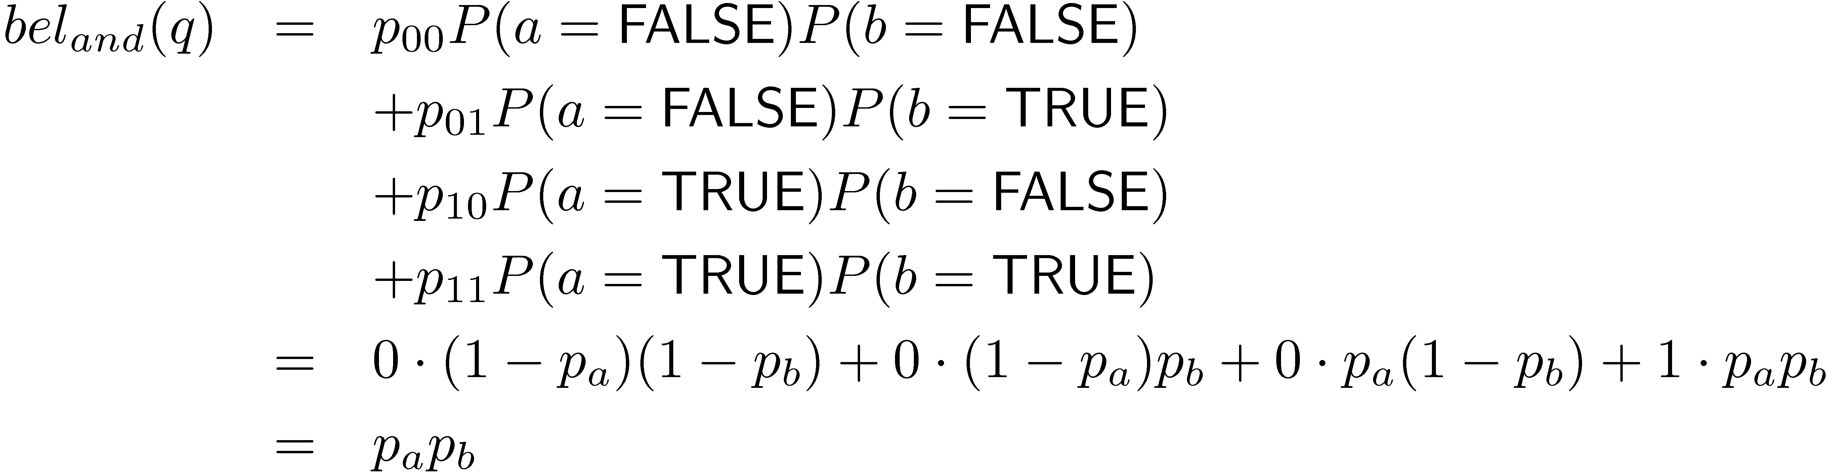
Example: AND Combination
Combination must consider all possible states of parents
Some combinations can be computed efficiently

Slide 67
Web Search
Most important, but not only, search application
Salient features
Size of collection
Connections between documents
Range of document types
Importance of spam
Volume of queries
Range of query types

Slide 68
Search Taxonomy
Informational
Finding information about some topic which may be on one or more web pages
Topical search
Navigational
finding a particular web page that the user has either seen before or is assumed to exist
Transactional
finding a site where a task such as shopping or downloading music can be performed

Slide 69
Web Search
For effective navigational and transactional search, need to combine features that reflect user relevance
Commercial web search engines combine evidence from hundreds of features to generate a ranking score for a web page
page content, page metadata, anchor text, links (e.g., PageRank), and user behavior (click logs)
page metadata – e.g., “age”, how often it is updated, the URL of the page, the domain name of its site, and the amount of text content

Slide 70
Search Engine Optimization
SEO: understanding the relative importance of features used in search and how they can be manipulated to obtain better search rankings for a web page
e.g., improve the text used in the title tag, improve the text in heading tags, make sure that the domain name and URL contain important keywords, and try to improve the anchor text and link structure
Some of these techniques are regarded as not appropriate by search engine companies

Slide 71
Web Search
In TREC evaluations, most effective features for navigational search are:
text in the title, body, and heading (h1, h2, h3, and h4) parts of the document, the anchor text of all links pointing to the document, the PageRank number, and the inlink count
Given size of Web, many pages will contain all query terms
Ranking algorithm focuses on discriminating between these pages
Word proximity is important

Slide 72
Term Proximity
Many models have been developed
N-grams are commonly used in commercial web search

Slide 73
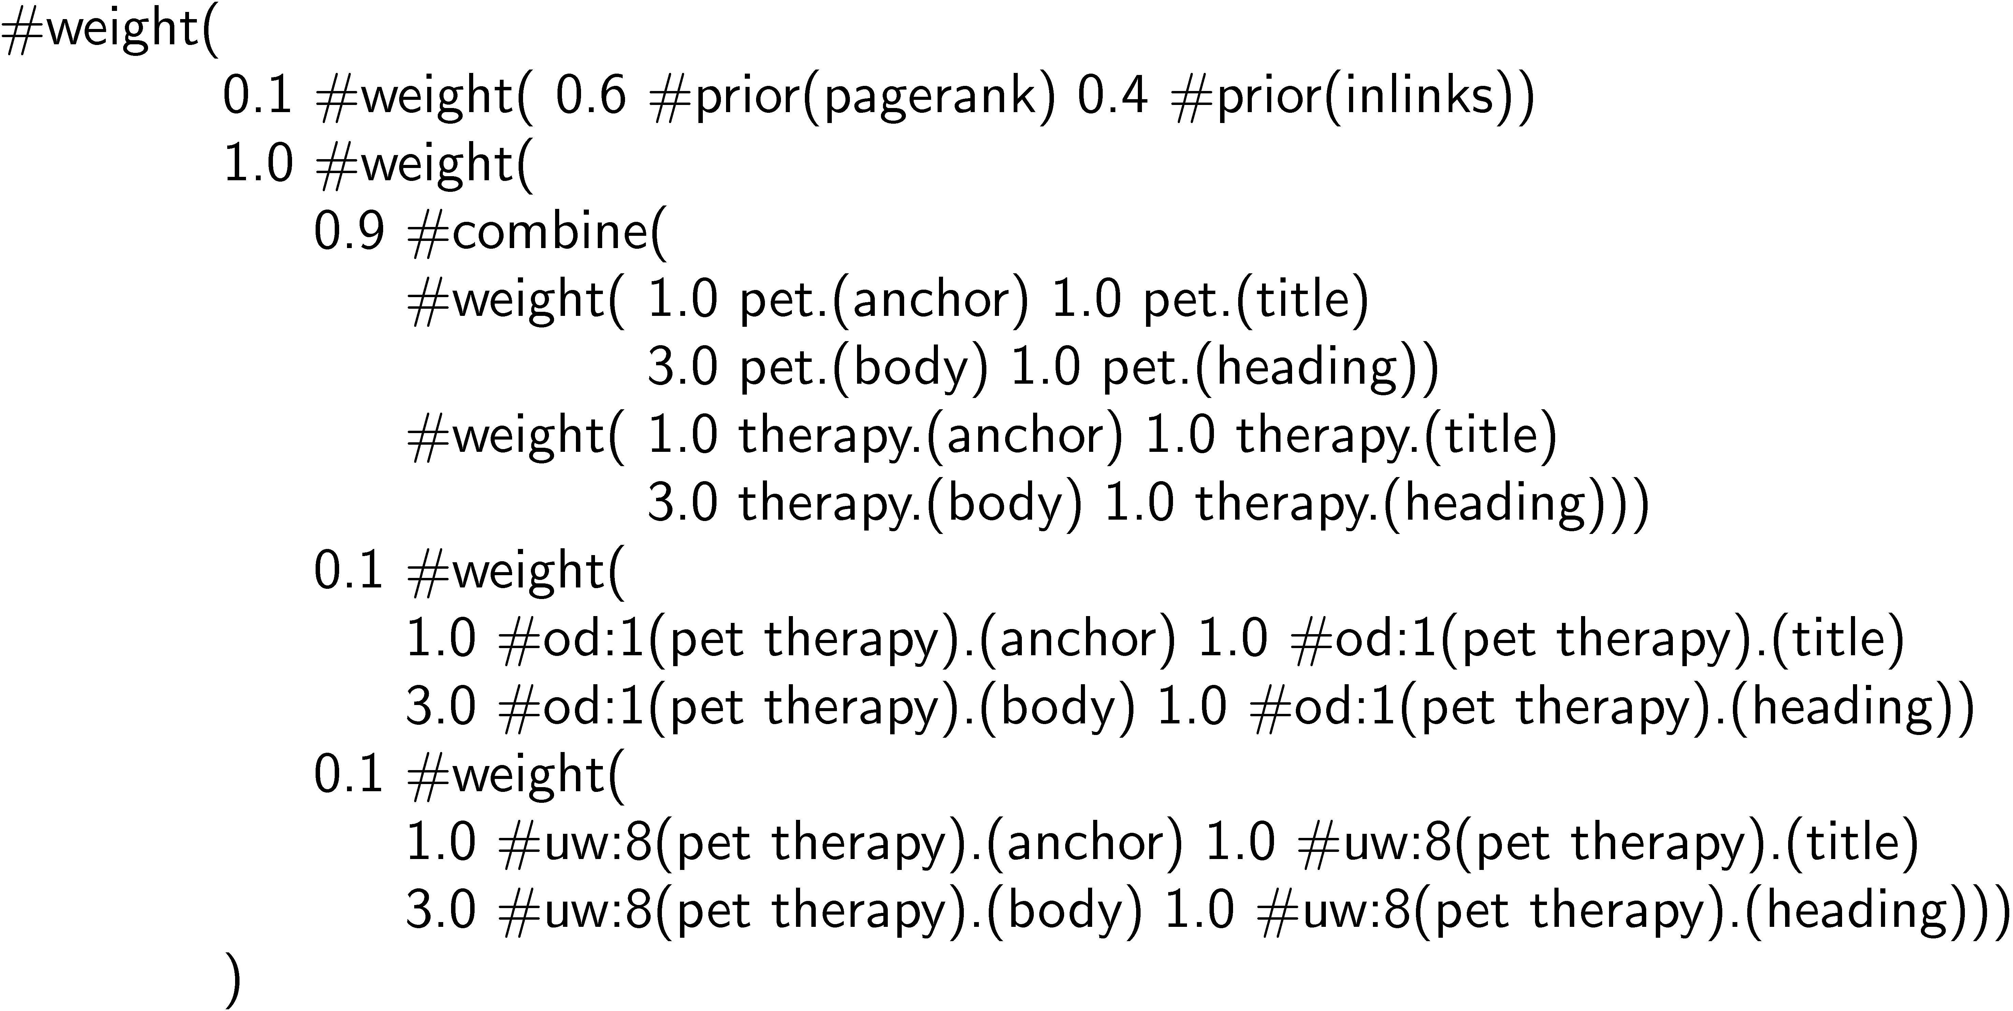
Example Web Query

